Slide 1
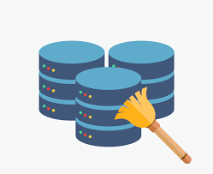
Dataset Details and Cleaning

Slide 2
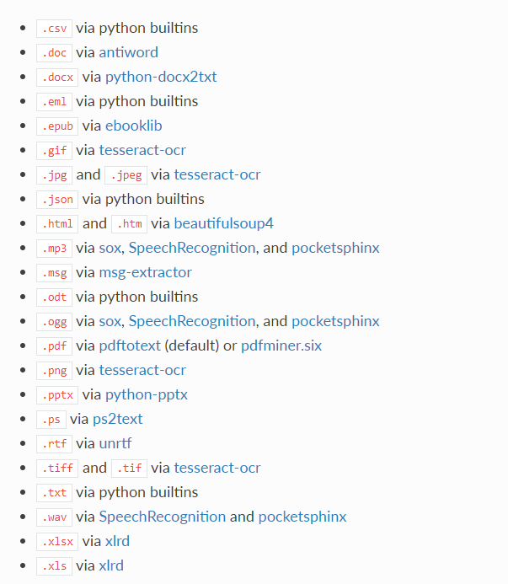
Textract
This package provides a single interface for extracting content from any type of file, without any irrelevant markup.

Slide 3
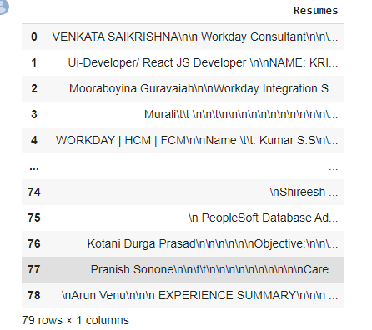
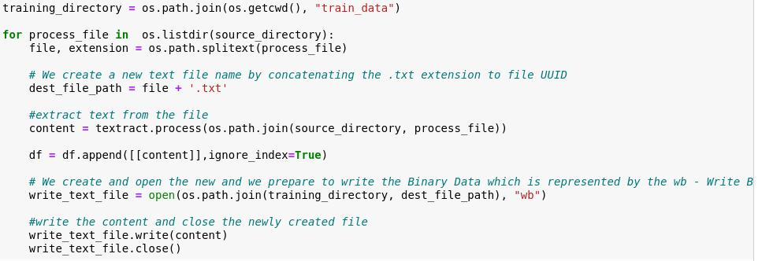
Converting text to .csv (Process)

Slide 4
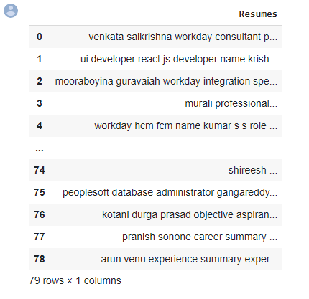
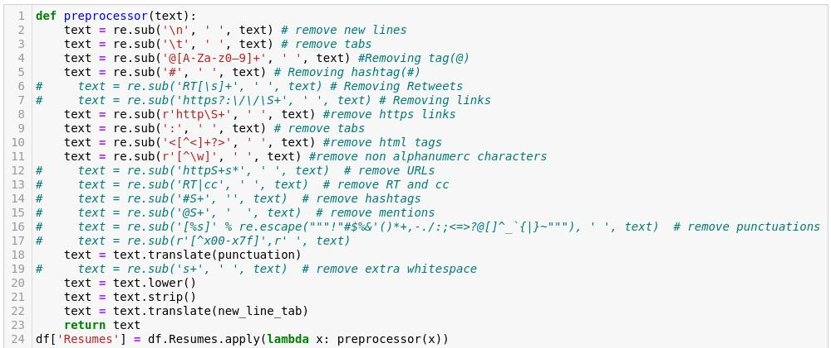
Removing Unwanted Character's
Unwanted Character’s like - \n \t, http links, tags, hastags, html tags, converting to lower case, removing white spaces etc.,

Slide 5
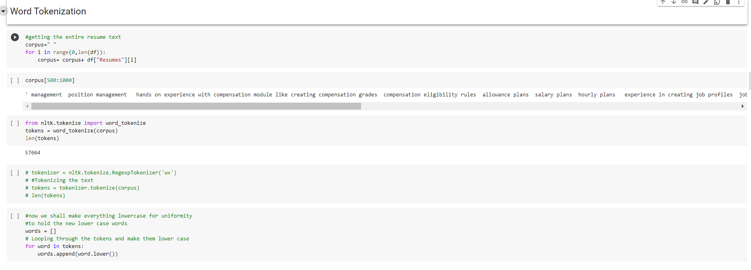
Word Tokenization
Tokenization is essentially splitting a phrase, sentence, paragraph, or an entire text document into smaller units, such as individual words or terms. Each of these smaller units are called tokens.

Slide 6
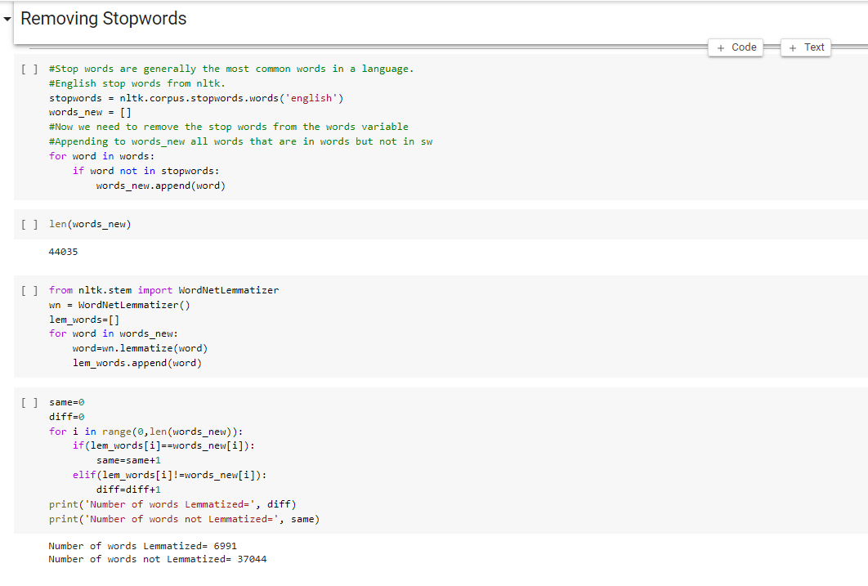
Removing stop wards
Stop Words: A stop word is a commonly used word (such as “the”, “a”, “an”, “in”) that a search engine has been programmed to ignore, both when indexing entries for searching and when retrieving them as the result of a search query.

Slide 7
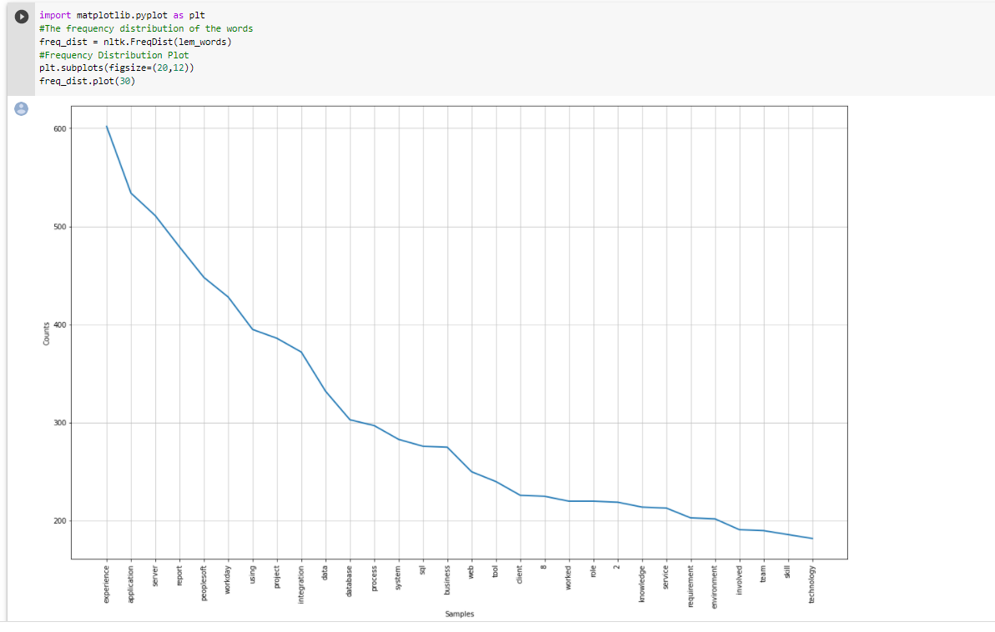
Word cloud and frequency plot

Slide 8
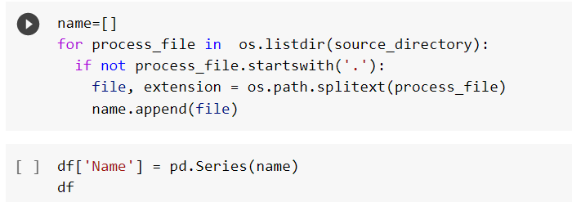
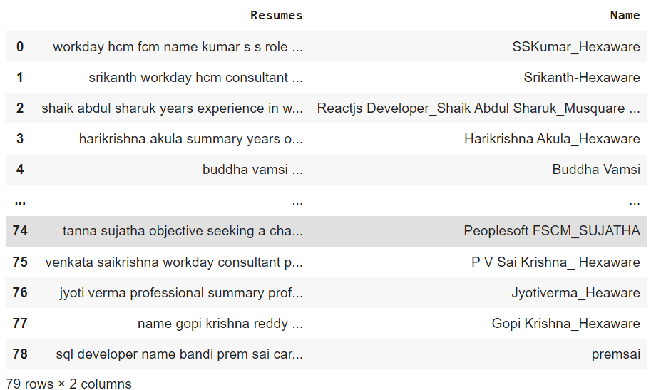
Labelling

Slide 9
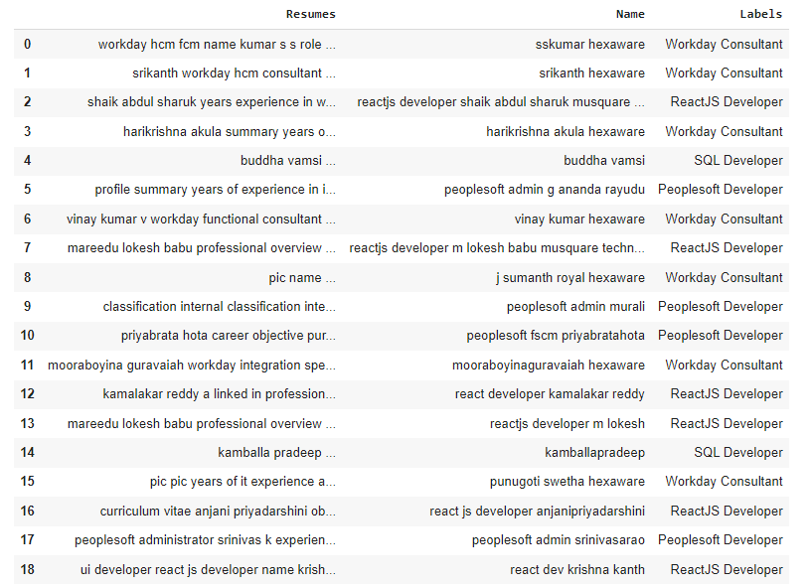
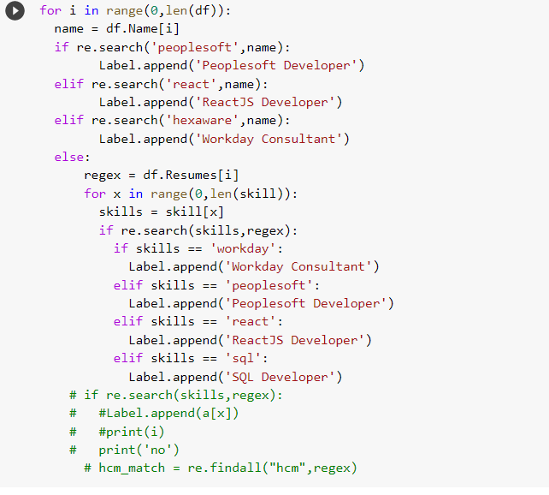

Slide 10
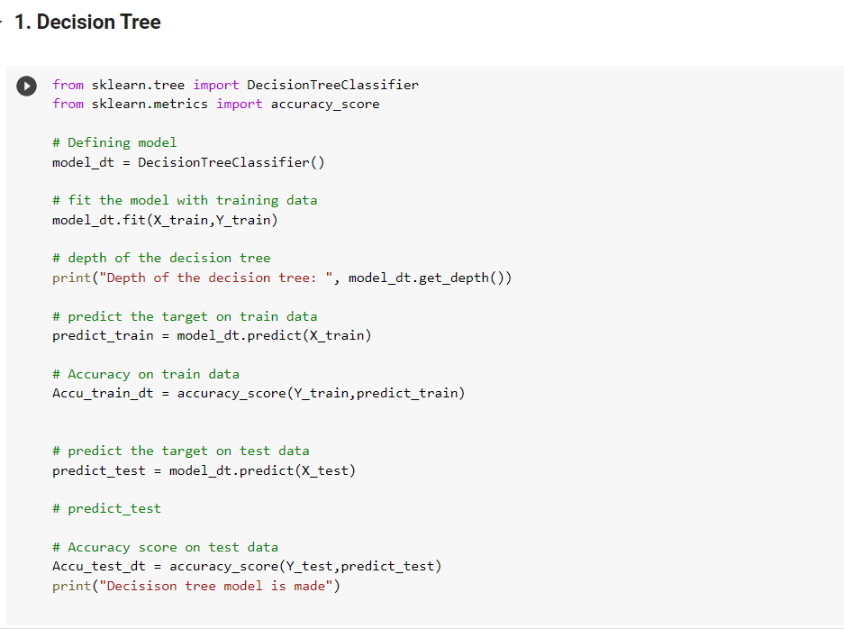
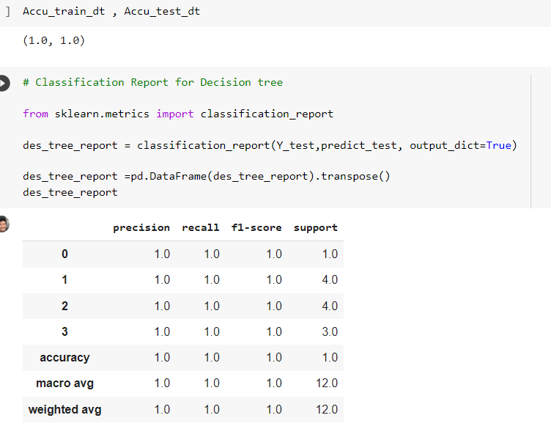
Decision Tree

Slide 11
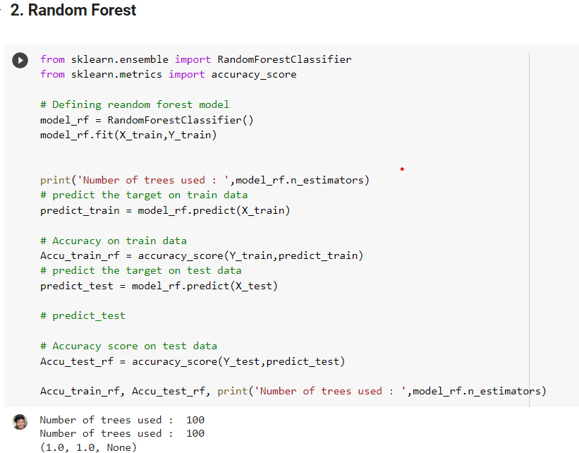
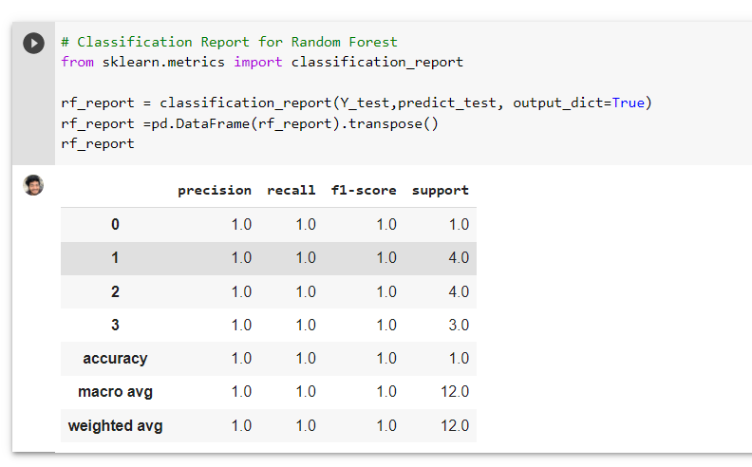
Random Forest

Slide 12
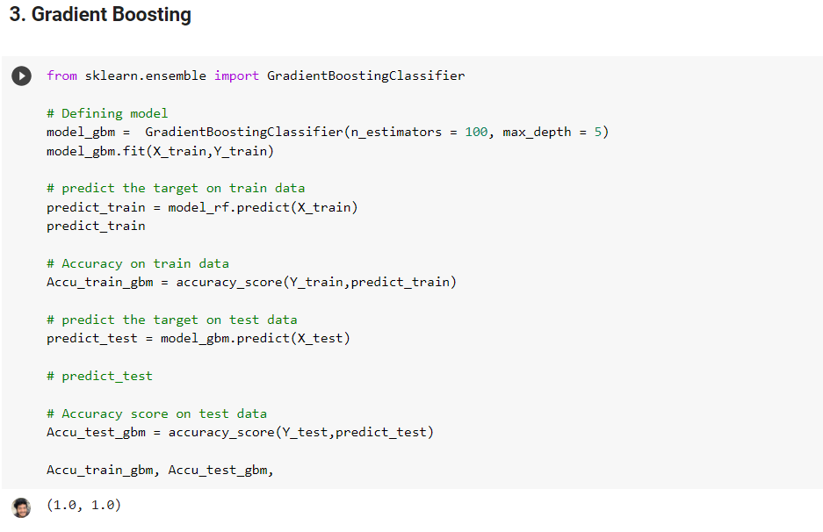
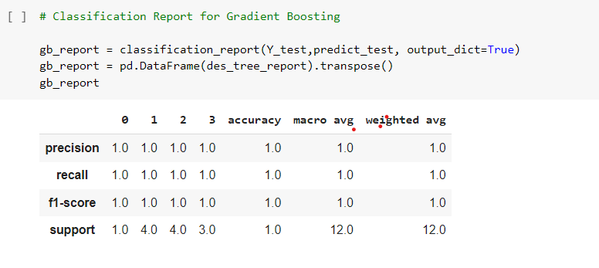
Gradient Boosting

Slide 13
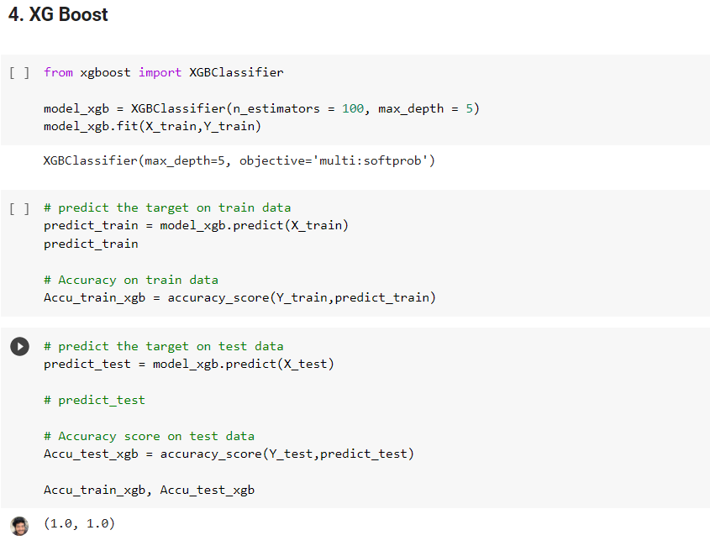
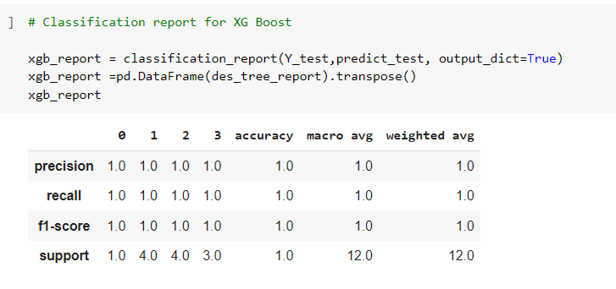
XG Boost

Slide 14
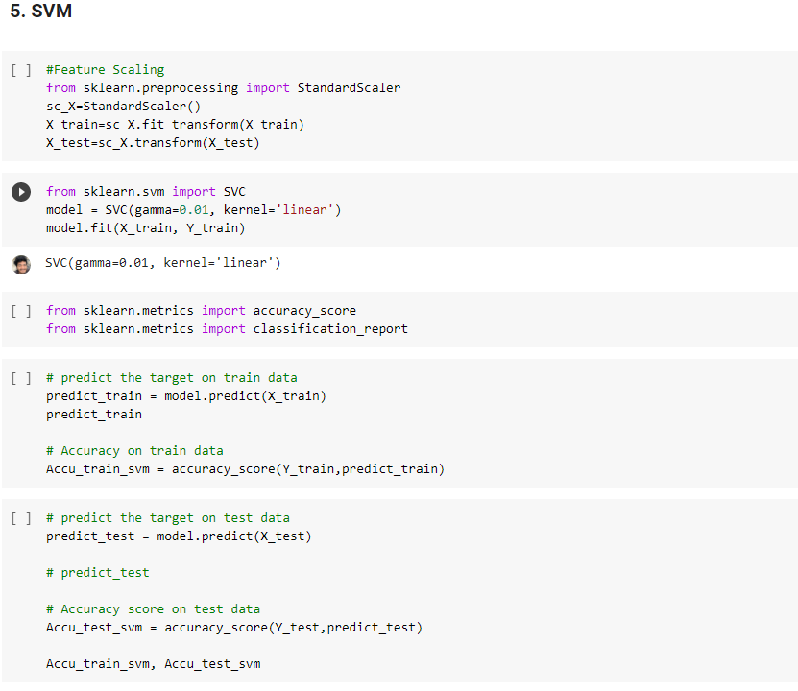
SVM

Slide 15
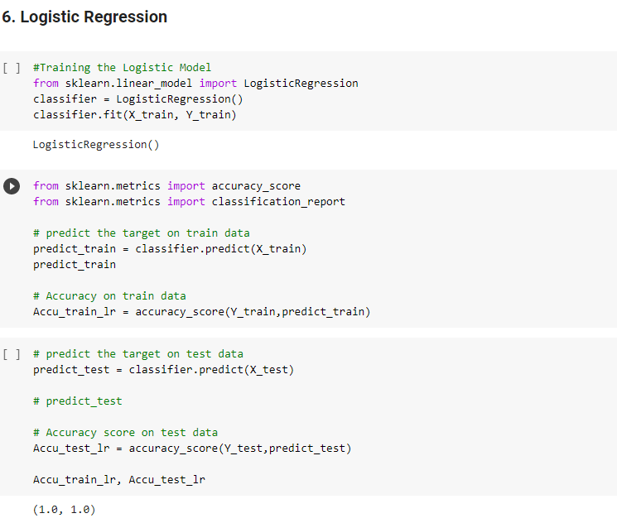
Logistic Regression

Slide 16
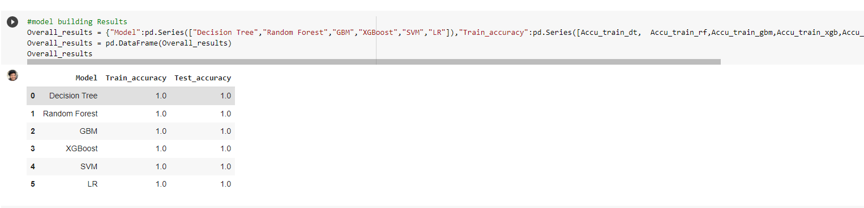
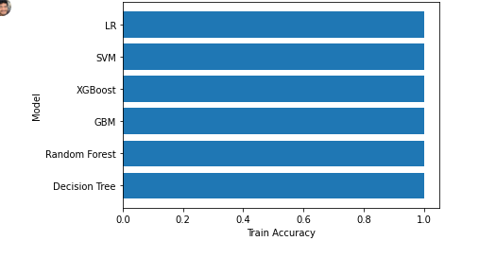
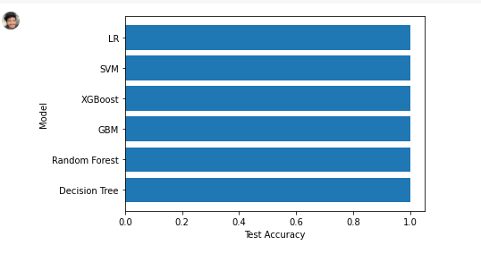
Evaluation
Train Accuracy
Test Accuracy

Slide 17
Thank you

